Slide 1
Category review: Chips
July 2023
Retail Analytics
Brand note: If client logo is not required, use alternate title page layout right click slide thumbnail > Layout > Title

Slide 2
Notes:
To view Privacy video explaining how important data privacy is to Quantium, please click here: https://www.youtube.com/watch?v=Zq1QDAkoRzU
or here Q:\Company Reference\Brand & Design\Brand videos\Q Privacy.mp4
At Quantium, we believe that data is the behavioural footprint of humanity and that it has to be treated with the utmost care and responsibility.
Histories, attitudes, indeed lives are stored within it in ways that aren’t always apparent – and that’s what makes its potential so powerful.
To work with it responsibly, sensitively, we set ourselves the highest data privacy protection and governance standards.
We have spent 17 years perfecting privacy-by-design and secure-by-design principles. Central to this is not holding any personally identifiable information about people –
we neither receive it, and put the necessary protections in place to be unable to decipher it.
Every aspect of handling data is safeguarded: from its de-identification, to its encryption – data security is paramount and of the highest grade.
We pride ourselves on gaining the trust of iconic organisations around the world through years of securely working with their data,
and in turn the trust that builds with their stakeholders.

Slide 3
Executive summary
01
Task 1
Chips transactions increased steadily before Christmas which can be an advantage with the help of promotional offers.
Most pack sizes are of 175g followed by 150g.
Kettle is the brand with most number of products sold.
Budget customers in Older Families account for max total sales.
02
Task 2
Trial stores 77 and 86 have significant increase in total sales and number of customers during trial as compared to control store.
Trial store 88 had increase as well but not as good as stores 77 and 86.

Slide 4
01
Category

Slide 5
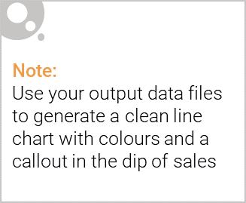
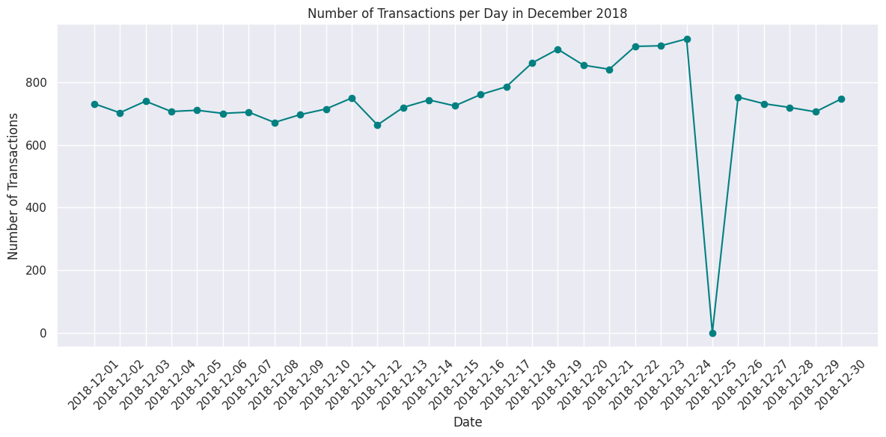
The day with no transaction is a Christmas day that is when the store is closed hence there is a dip in sales on 25th December as shops were non-operational.
Sales increase steadily as the Christmas day approaches and return again to early December sales level during New Year Eve.

Slide 6
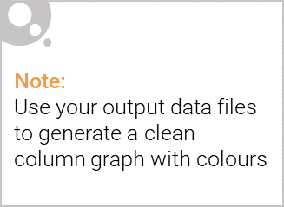
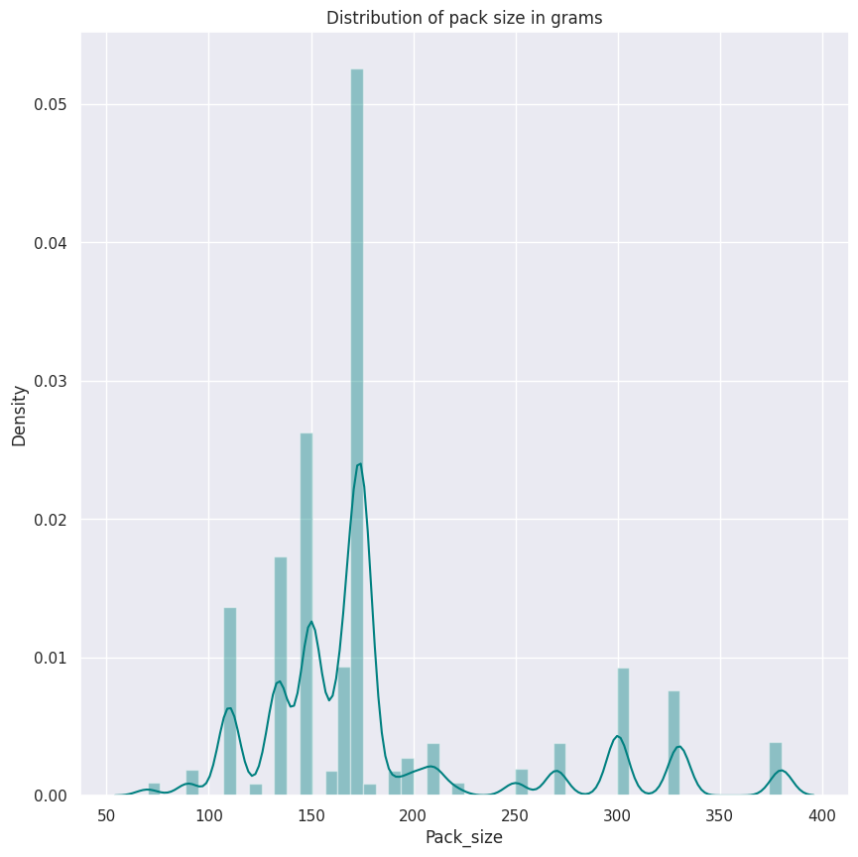
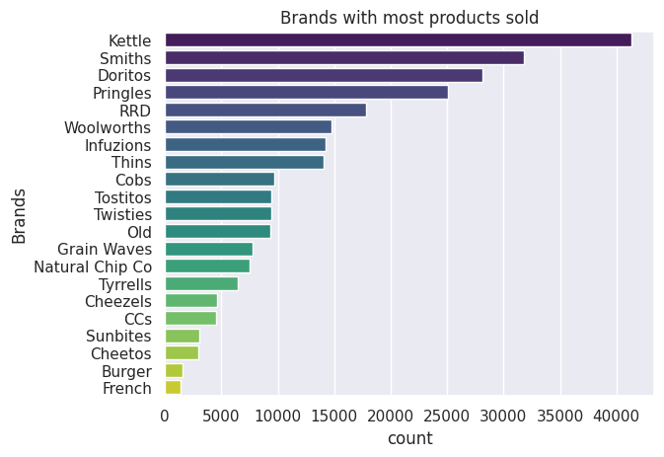
Most pack size are of 175g and Kettle is the brand with most product sold.

Slide 7
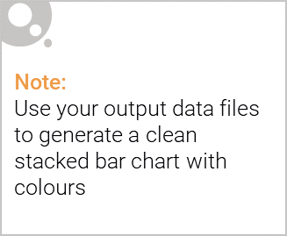
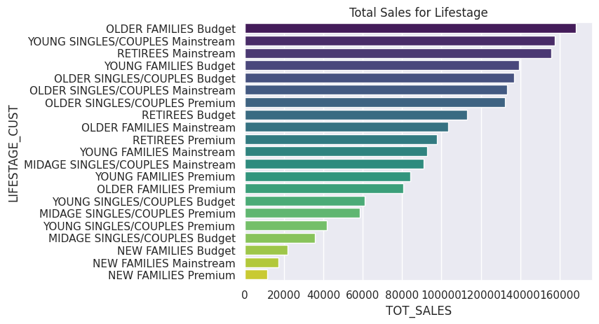
Editable (delete this)
Budget customers in Older Families account for the max of total sales. This is followed by Mainstream customers in Young singles/couples and Retirees

Slide 8
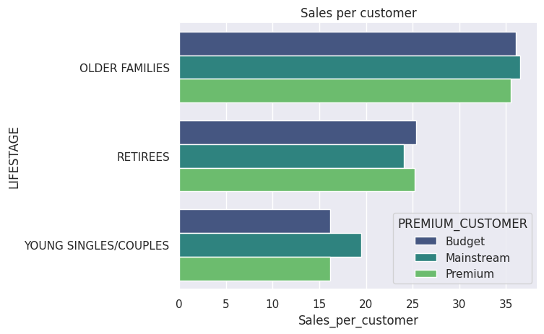
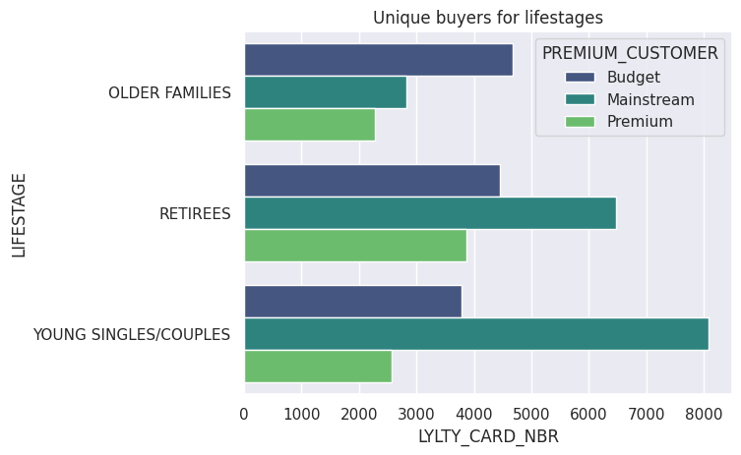

Slide 9
02
Trial store performance

Slide 10
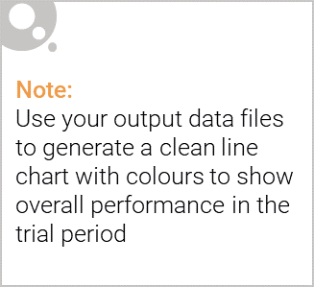
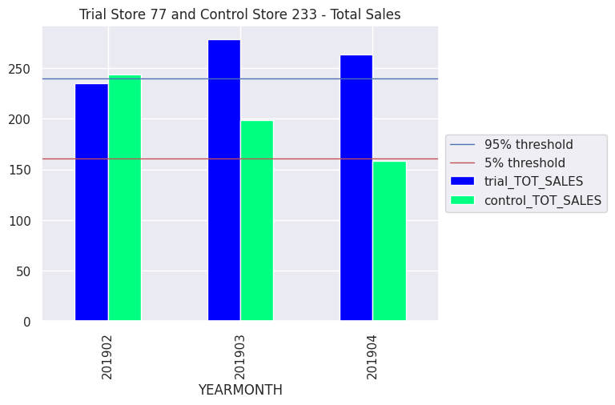
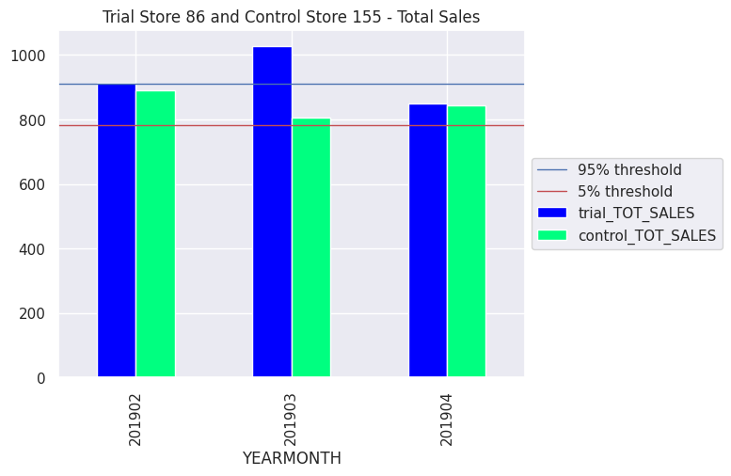
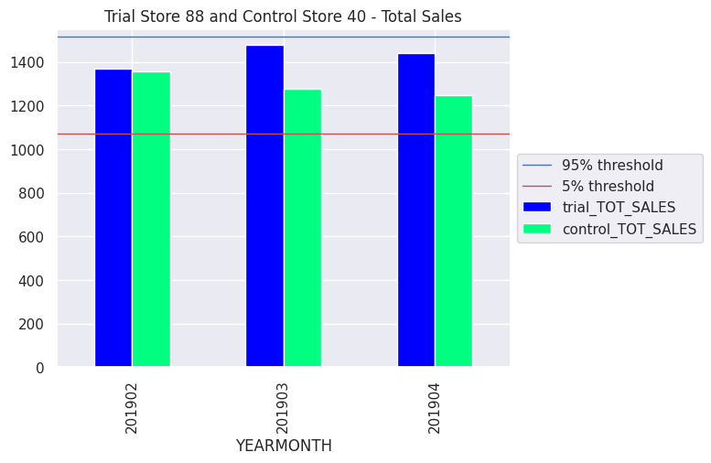
We can see that Trial store 77 sales for March, and April exceeds 95% threshold of control store. Same goes to store 86 sales March month. Whereas trial store 88 sales increase is insignificant.

Slide 11
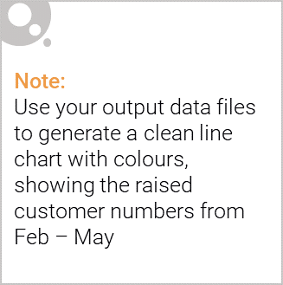
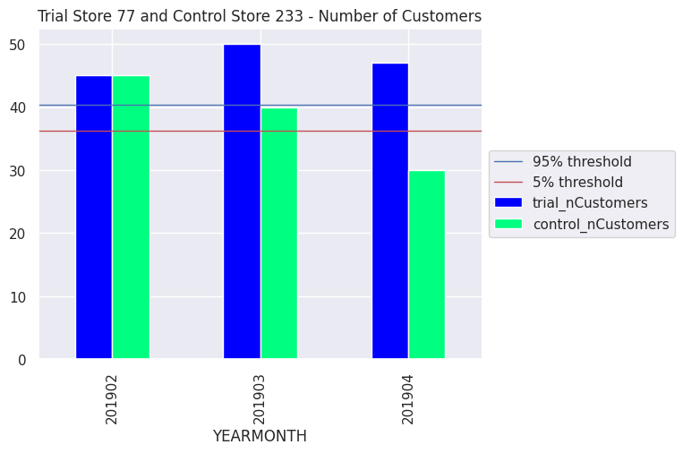
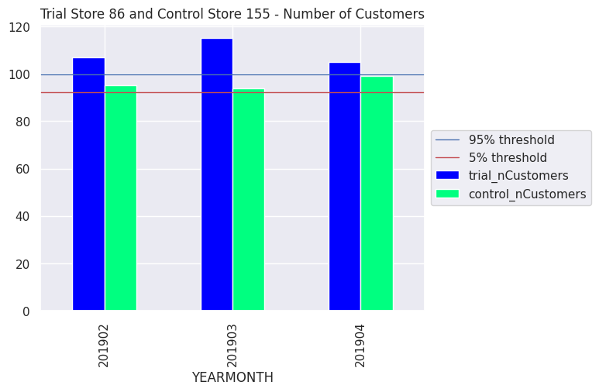
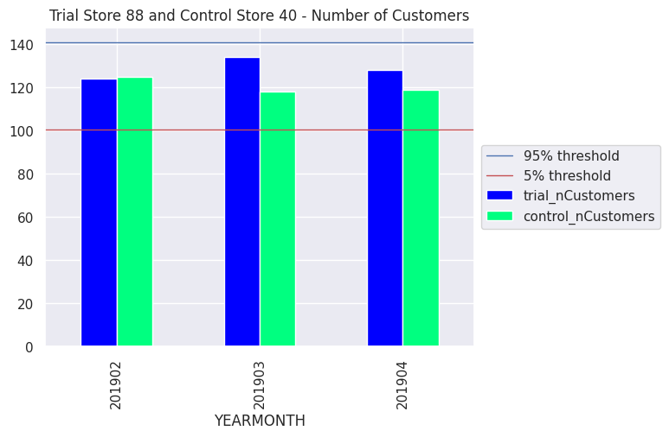
Both trial store 77 and 86 showed significant increase in Total Sales and Number of Customers during trial period. But not for trial store 88. Perhaps the client knows if there's anything about trial 88 that differs it from the other two trial. Overall the trial showed positive significant result

